Slide 1


Mahatma Education Society’s Pillai College of Engineering, Panvel Department of Computer Engineering’s
A Mini Project Presentation on
FOOD ORDERING WEB APPLICATION
Under the Guidance of
Prof. Alamuri Vasavi
Group Members :-
Shreeyash Patil CEB343 (Leader)
Aditya Khopade CEB326
Zaid Khalfe CEB325
Nitesh Pandey CEB340

Slide 2
OVERVIEW
1. INTRODUCTION
2. MOTIVATION
3. ABSTRACT VIEW
4. LIMITATIONS OF EXISITING SYSTEM
5. PROPOSED SYSTEM
6. FLOWCHART
7. WORKING
8. REQUIREMENTS
9. RESULT
10. FUTURE WORK
11. CONCLUSION
12. REFERENCES

Slide 3
INTRODUCTION
Food Ordering Website is aimed at facilitating the users with delivery of meals from local restaurant and helping the local restaurant in order and inventory management. This system is a website that can be accessed by the users using an URL and get the meal delivered.
Our system has an accessing mode for administrator . Food Ordering Website is managed by an administrator. It is the job of the administrator to decide the menu and monitor the transaction process.
Administrator can perform the following operations Add the menu data, Update the menu data and Delete the menu data. They can also view the order receipt data and the payment status.

Slide 4
MOTIVATION
The Reason for going ahead for this project was to create a User friendly website.
It provides a clean and easy to understand interface for both the user as well as the administrator.
It lightens the manual work for the administrator.
It reduces paper work.

Slide 5
Abstract view
The project titled as Food Ordering web based application developed to interface for both the user as well as the administrator(Restaurant).
This project contains three modules - Restaurant module, Customer module, Deliver module.
Restaurant Module is used by the Admin to add, update and delete Menu items. Admin can check the order details and transactions using this module. Admin can also set the number of users those can access the Restaurant system.
Customer Module is used by the customer or user to view the menu and select the items of their choice.
Deliver

Slide 6
LIMITATIONS OF EXISTING SYSTEM
Currently the system is totally manual.
The manual system is slow than the computerized system.
It is very time consuming as only one person can order at a time.
It is very tiresome to maintain all the previous data.
It does not allow the user to have any info of the menu items.
It causes more wastage of paper to give out receipts.

Slide 7
Proposed system
The new system is totally computerized system.
It provides security and authorization to the administrator as well as the user.
It saves time and cost.
It is user friendly.
In new system, it uses less man power than manual system.
In this, the data requires less space to store than the manual system.
It reduces wastage of paper.

Slide 8
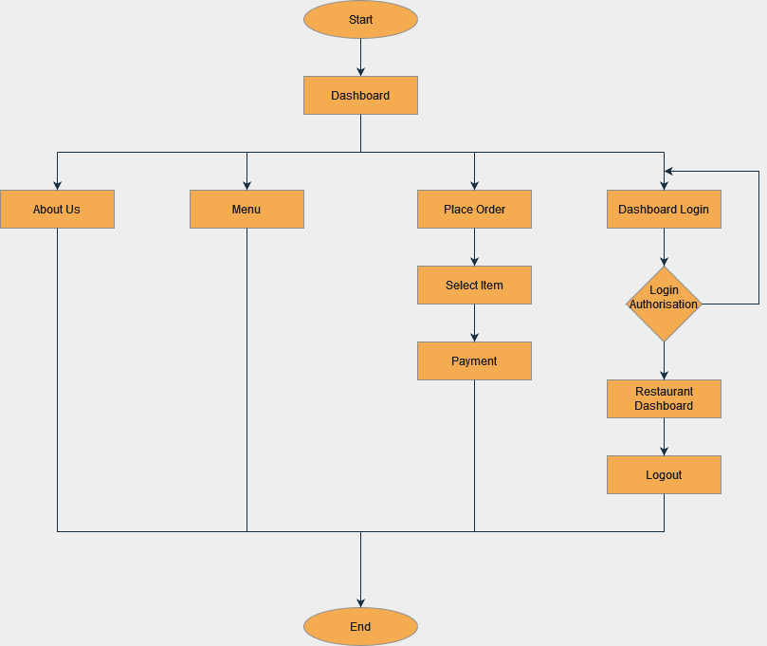
FLOWCHART

Slide 9
WORKING
On the main page the user will get to open the restaurant menu and a button to place an
order.
After the user clicks on Place an Order, he/she will be able to select the food items of
their choice and will have to enter their details at the end of the page. To proceed with the
order, Submit Order needs to be clicked which will direct them to the order summary
page.
The order summary page will have an option for payment using PayPal. Once the users
click on the payment option and completes the transaction, they will be directed to the
Order Submitted page.
Admin or Restaurant manager can manage the restaurant inventory and staff login from
the Django admin page.
He can add, delete, view payment details and also can make any changes in the existing
records of orders.
To access the restaurant management page, the admin can login through the login option
on the main page. Admin can see the orders, total orders, and total revenue of the day.
Admin can check the order details of each order from the list and can mark the orders as
shipped if the order is received by the costumer.

Slide 10
REQUIREMENTS
Requirements :-
OS platform : Windows 11, MacOs.
Front end : HTML, CSS, Django, Python.
Back end : Django.
Software : Sublime text editor, .
Browser : Google Chrome, Apple Safari or any supported browser.

Slide 11
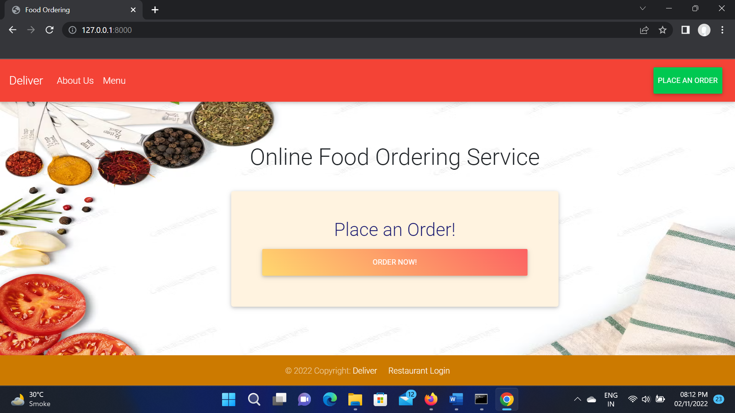
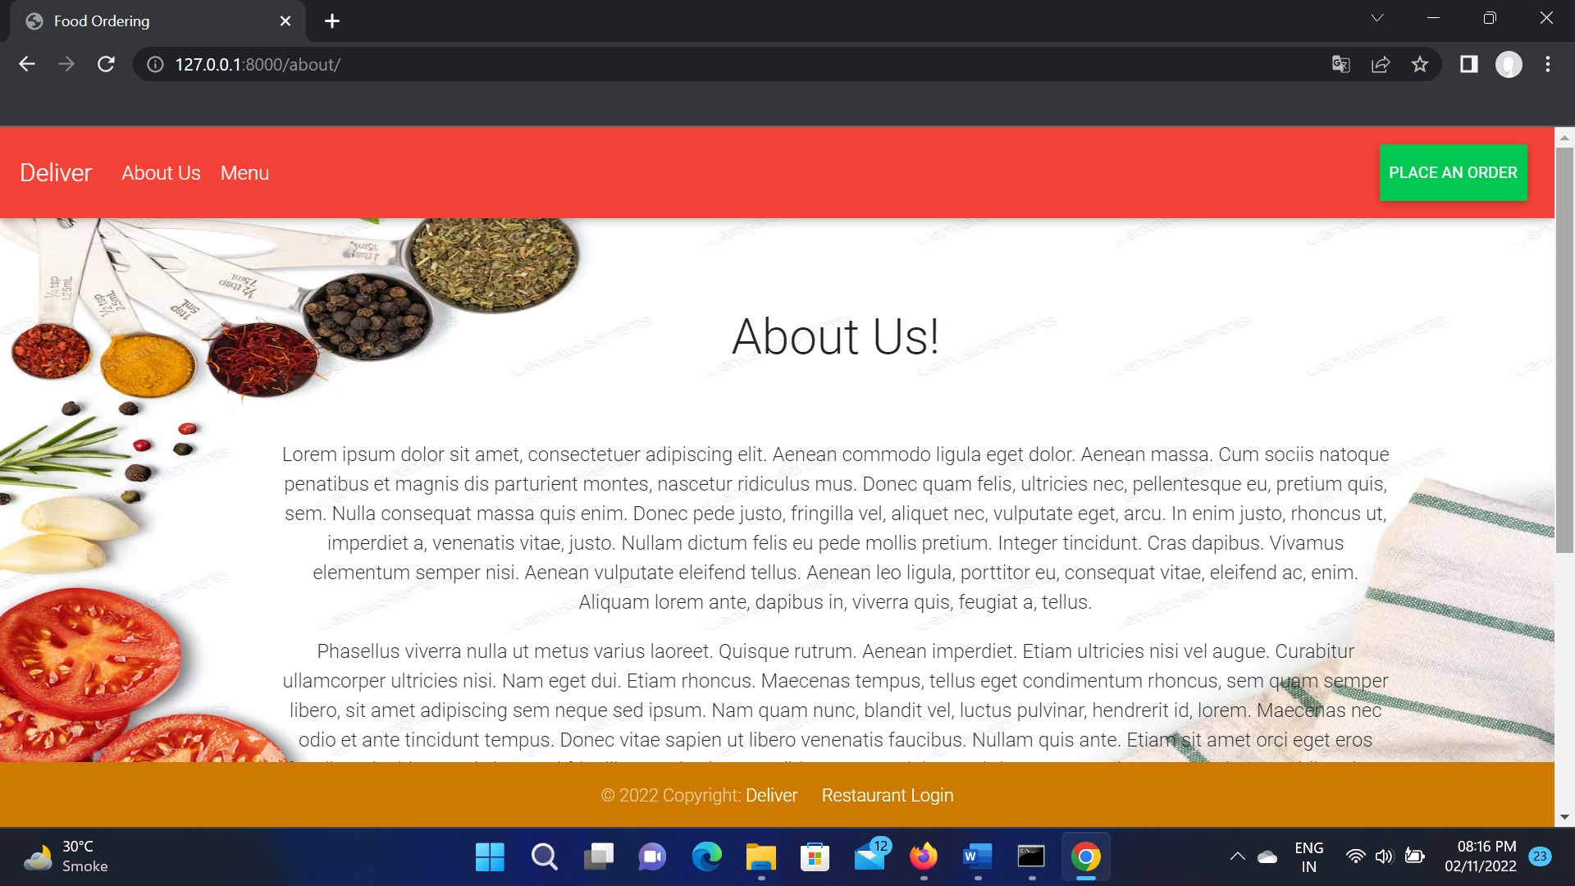
RESULT

Slide 12
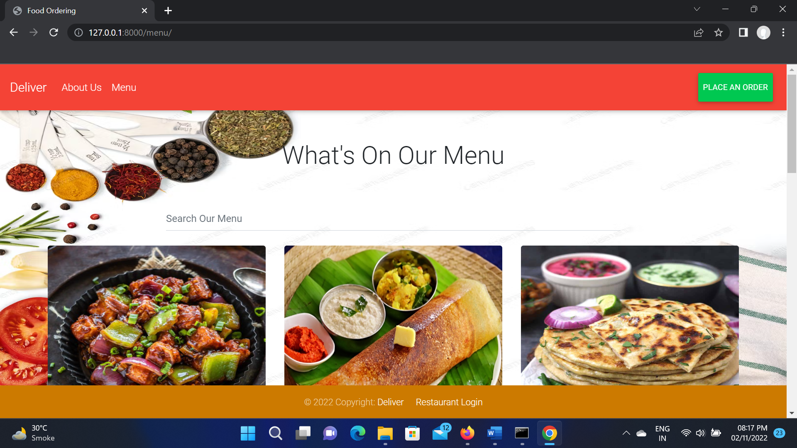
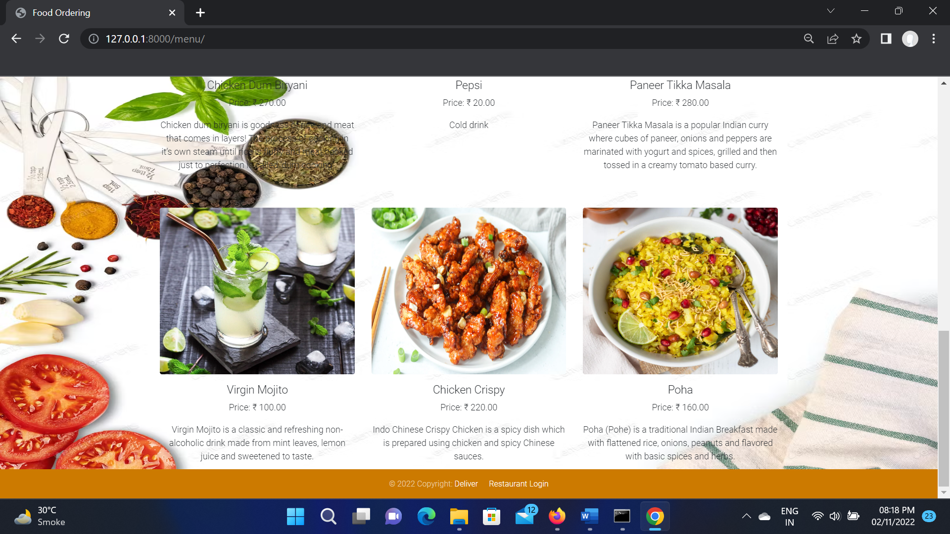
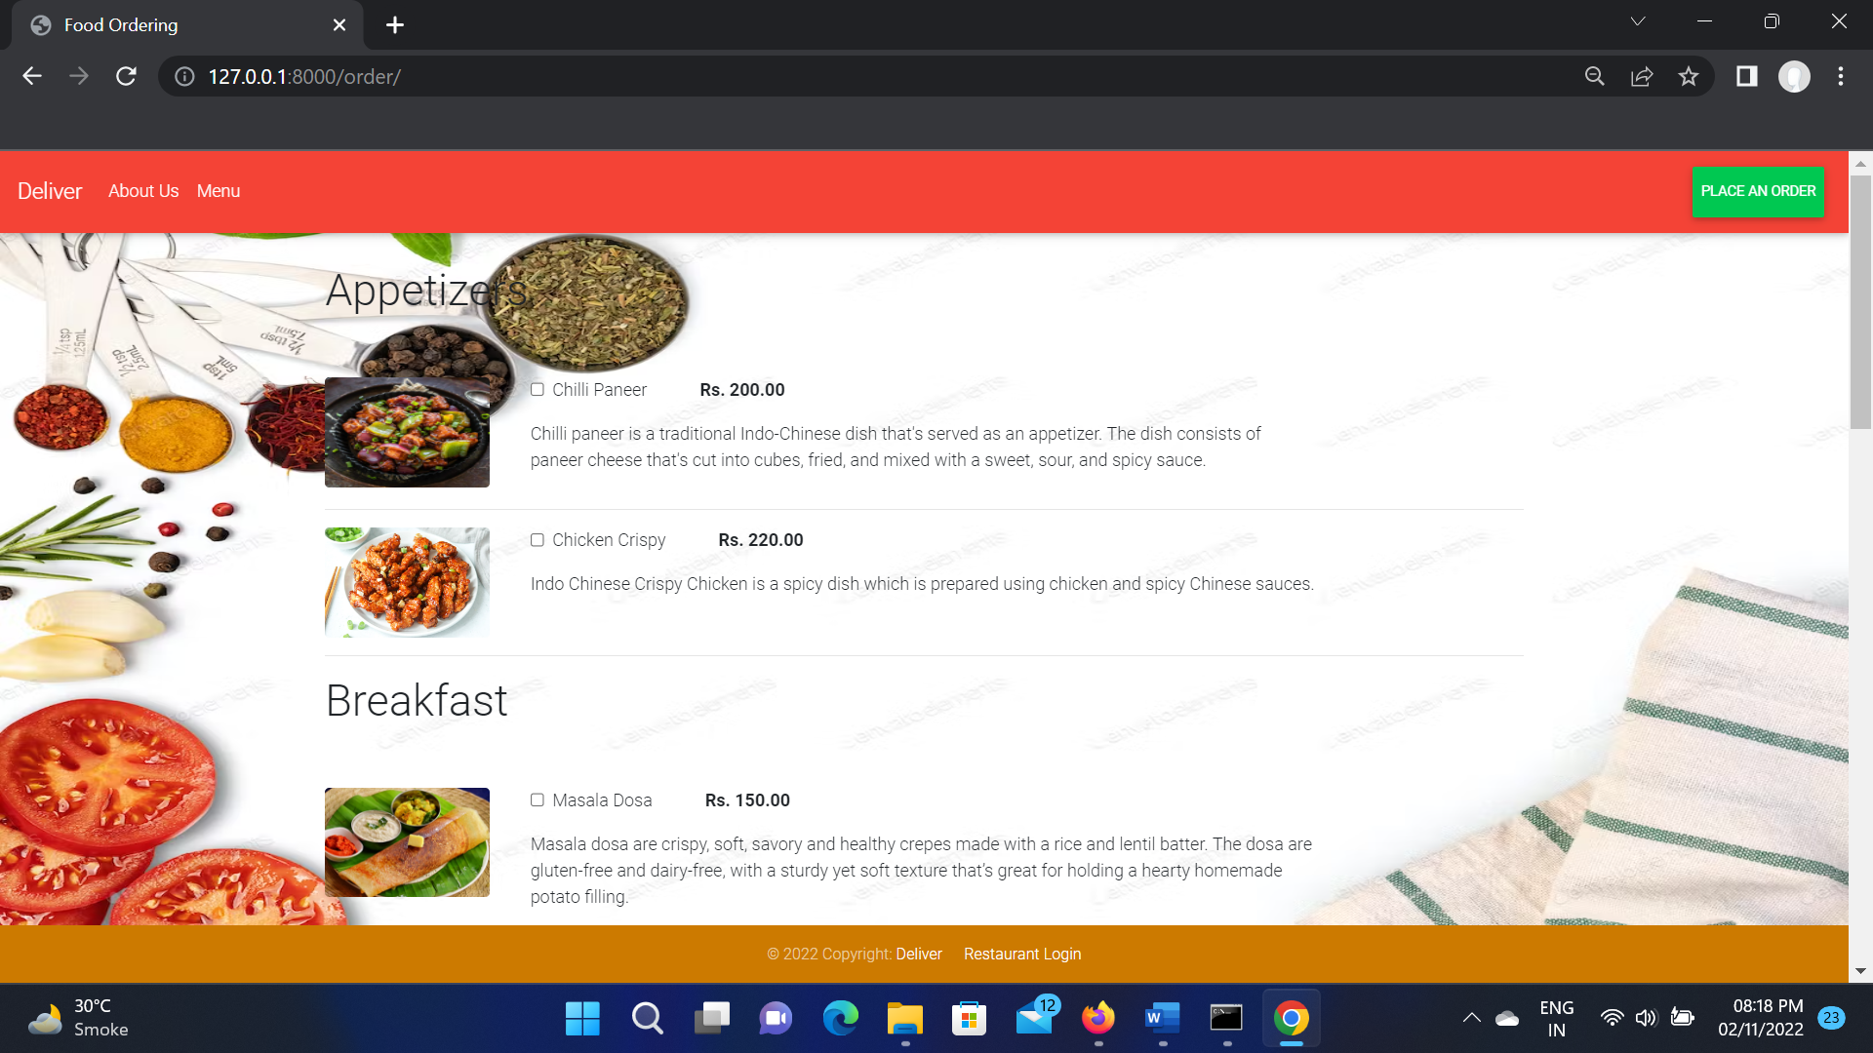
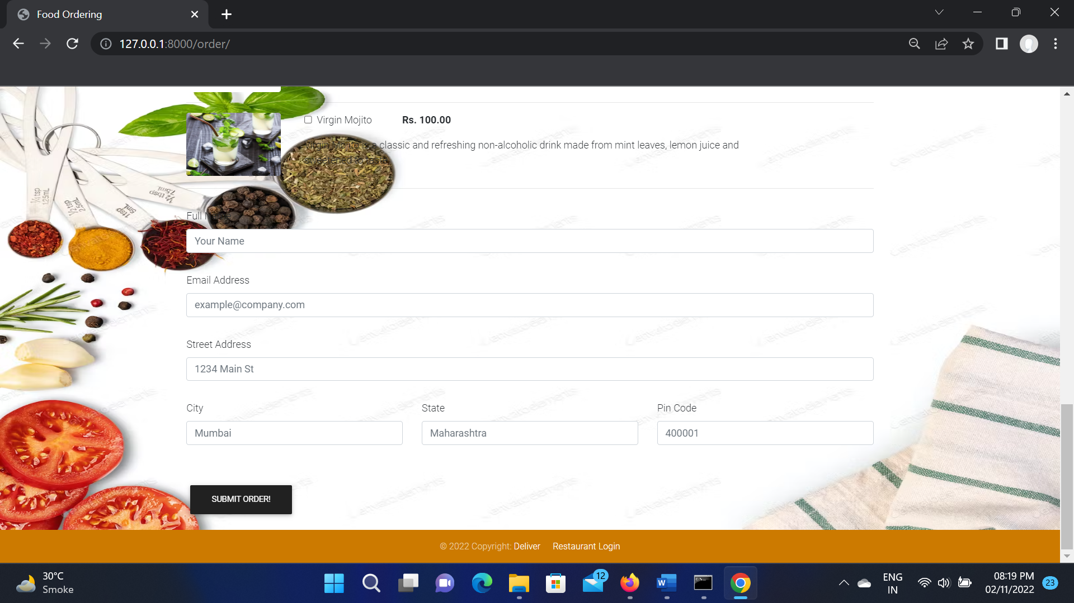

Slide 13
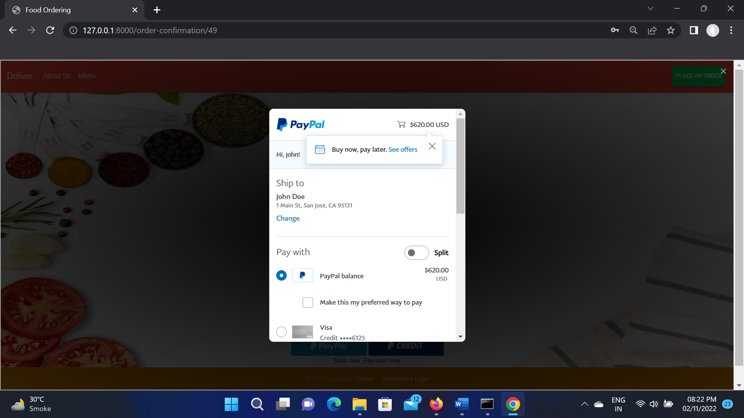
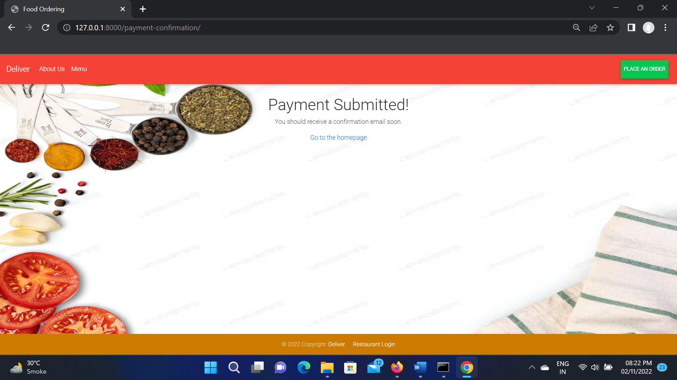
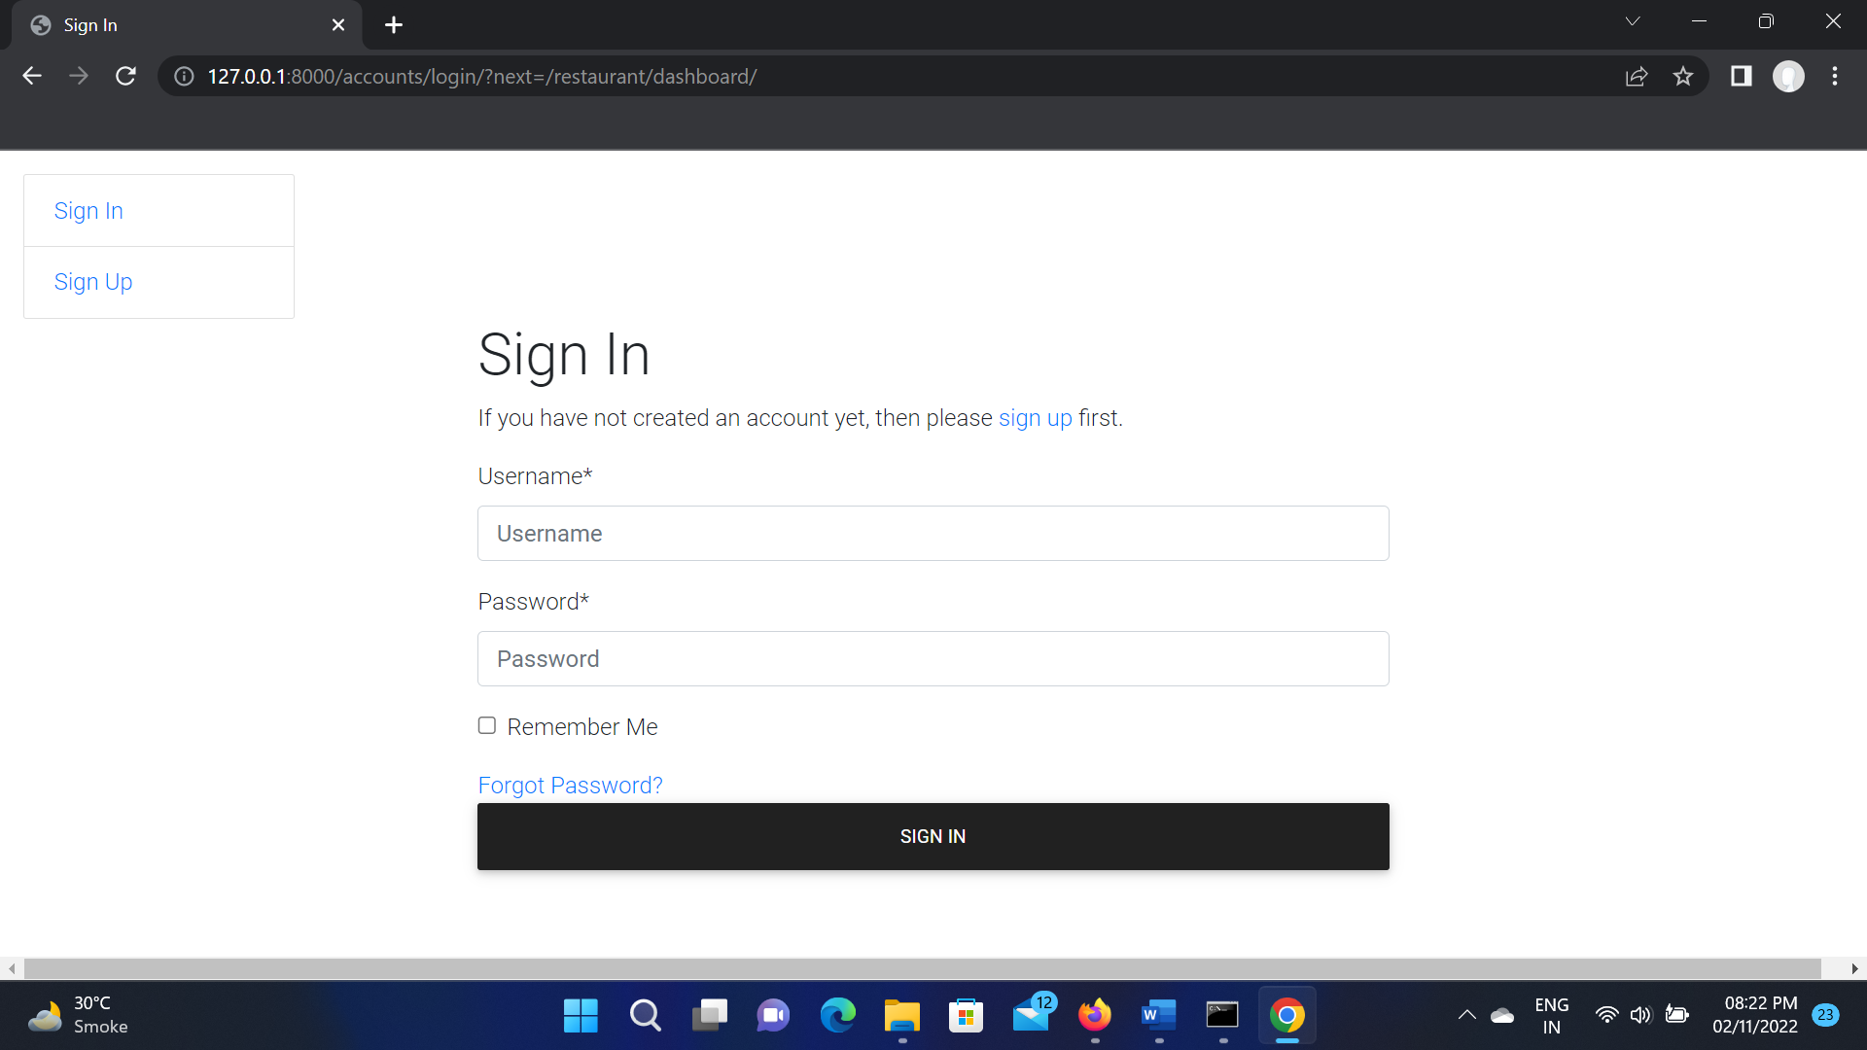
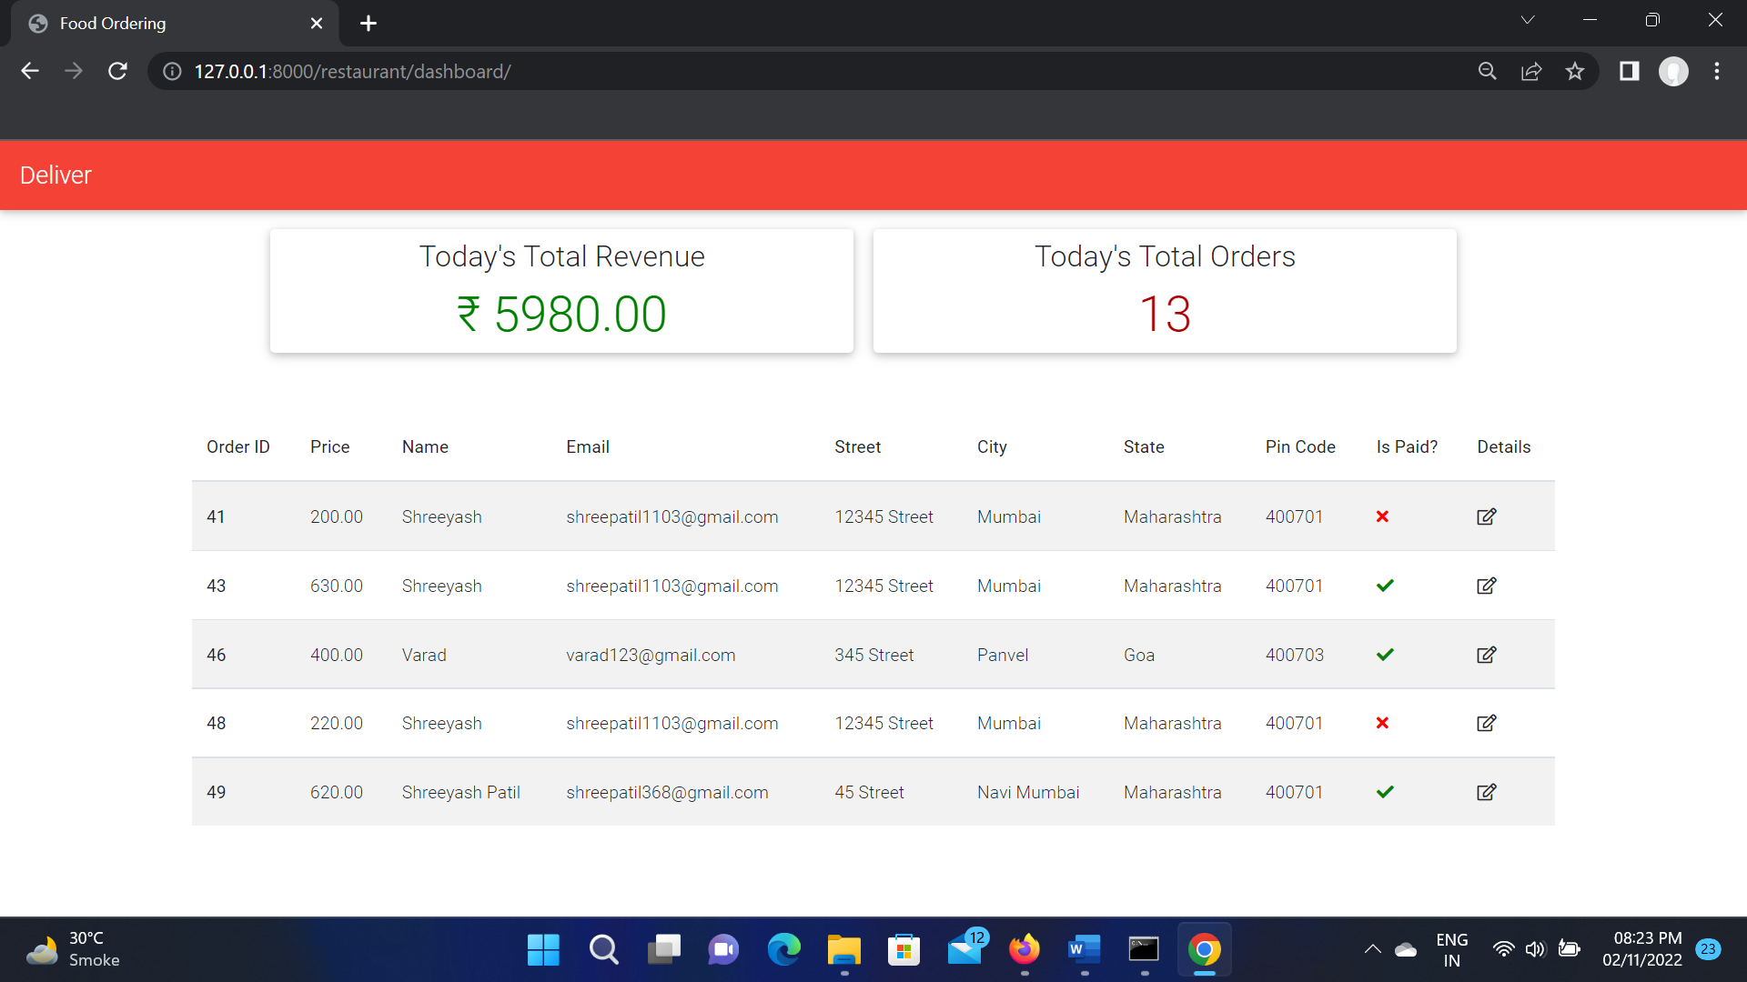

Slide 14
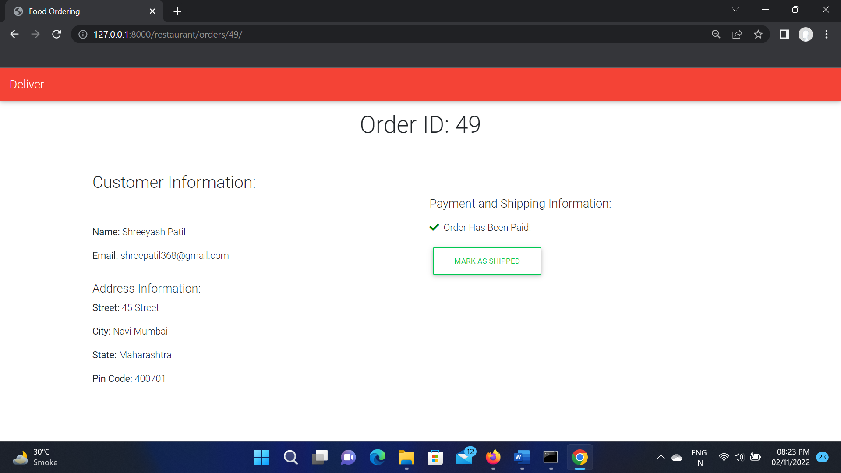
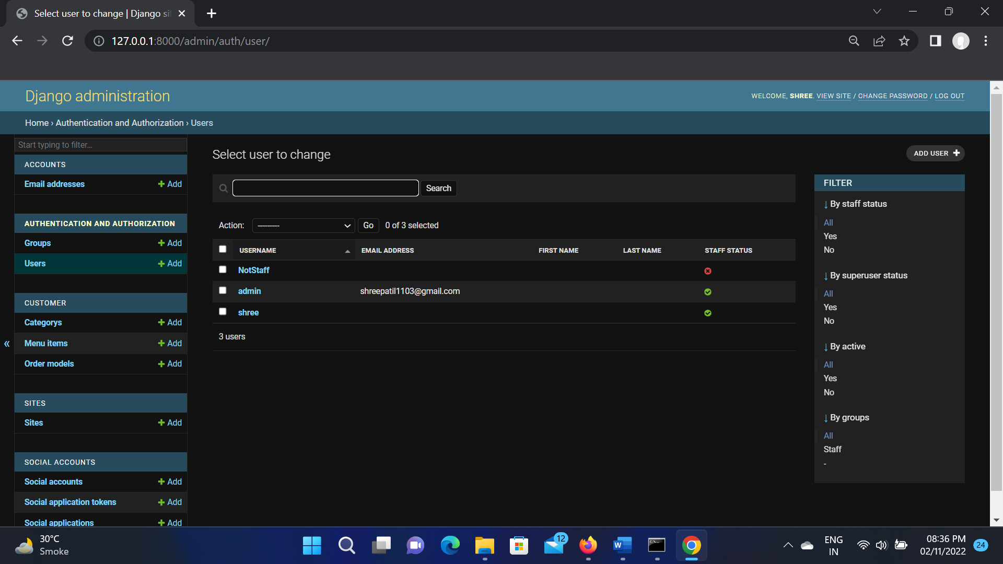
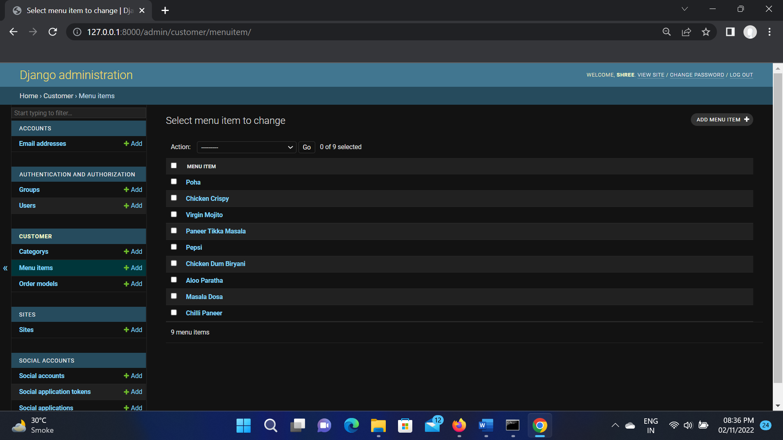
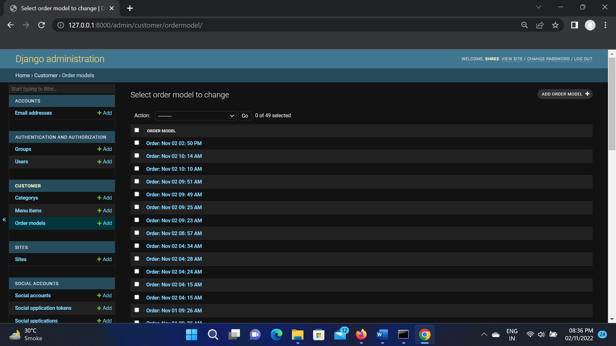

Slide 15
FUTURE WORK
For future work the following features are to be added.
Receipt Mail Sending.
More advanced features like order tracking, bill splitting,
delivery reviewing and automated consumer care services.
Online payment gateway would be added.

Slide 16
References
https://www.djangoproject.com/
https://getbootstrap.com/
https://bootstrapmade.com/
https://developer.paypal.com/
https://www.w3schools.com/
https://stackoverflow.com/
https://www.javatpoint.com/

Slide 17
CONCLUSION
Conclusion :-
Thus we have successfully developed a Food Ordering Website for efficiently using
creating a friendly user experience for the Users as well as the Local Restaurant.

